Slide 1

Supply-Demand Forcasting
Geng, X., et al. “Spatiotemporal multi-graph convolution network for ride-hailing demand forecasting”, 2019 AAAI.
Wang, S., et al. “Causal Probabilistic Spatio-temporal Fusion Transformers in Two-sided Ride-Hailing Markets”. 2021, in submission.

Slide 2







Supply-Demand Forecasting
The Problem
The Goal
Predicting the demand-supply distribution
Improve the service quality
Model
Drivers
Multi-modal data fusion
Complex spatio-temporal patterns
Reduce empty driving
Transfer
Riders
Heterogeneous space among cities
Heterogeneous feature among tasks
Intelligent travel guidance
Less queueing time
Recognition
Platform
Causal inference
Model interpretation
Impact analysis
Fill demand-supply gap
Recognize the market
Better dispatching and scheduling
MORE THAN JOURNEY didiglobal.com

Slide 3
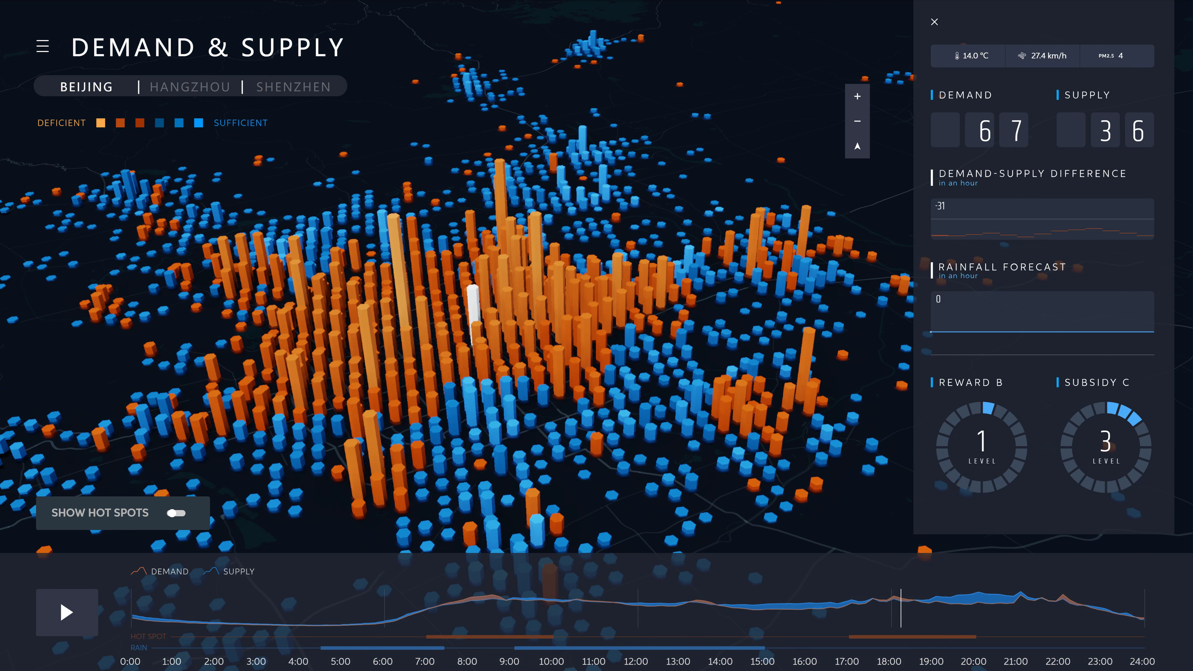
Supply-Demand Network Prediction
If we “foresee” future orders:
Get prepared for future peak hours
Dispatch vehicles for regions with higher demand
Detect abnormal road conditions
Respond to emergencies
Demand forecast “empowers” better strategies and services
Notes:
右侧demo需要替换为最新的nips demo的供需诊断录屏(12.4完成）

Slide 4
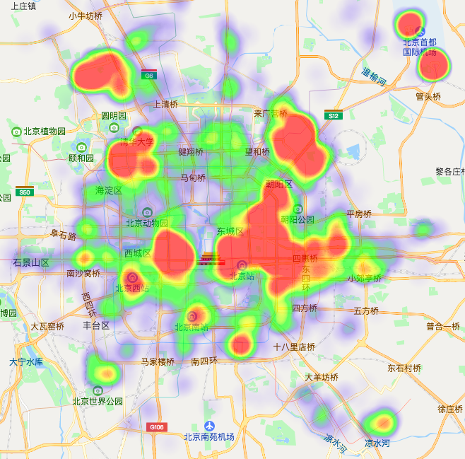
A Deep S-T Forecasting Model
Graph Generation
Spatio-temporal Forecasting
Incorporating
multi-relationship
Temporal: CGRNN
Contextual-gated
temporal modeling
RNN
History
Spatio-MGCN
Non-euclidean
spatial modeling
Forecast
MORE THAN JOURNEY didiglobal.com

Slide 5
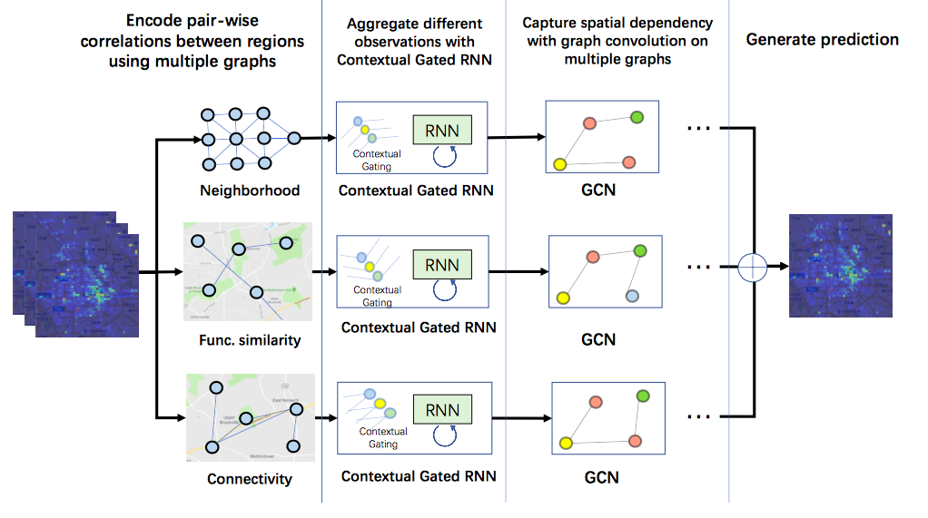

Formulation of three graphs
Multi-graph model architecture
Define the relationship between region $v_{i}$ and $v_{j}$:
Neighborhood
$$A_{N,ij}=\left\{\begin{aligned}1,v_{i} \text{and} v_{i} \text{are} \text{adjacent} \\ 0, \text{otherwise} \end{aligned}\right.$$
POI Similarity
$$A_{S,ij}= {<P_{v_{i}},P_{v_{j}}>}/{|P_{v_{i}}|∙|P_{v_{j}}|}$$
Road connectivity
$$A_{C,ij}=max⁡(0,I_{conn}\left(v_{i},v_{j}\right)−A_{N,ij})$$
Aggregation function of Graph Convolution Network (GCN)
$$X_{l+1}=\sum_{A ∈ 𝔸}{AX_{l}W_{l}}$$
$$𝔸=\{A_{N},A_{S},A_{C}\}$$
Evaluating importance of graphs by ablation study
Removed component | Error (RMSE)
Neighborhood | 11.47
POI Similarity | 11.42
Road connectivity | 11.69
Original model | 10.78
MORE THAN JOURNEY didiglobal.com

Slide 6
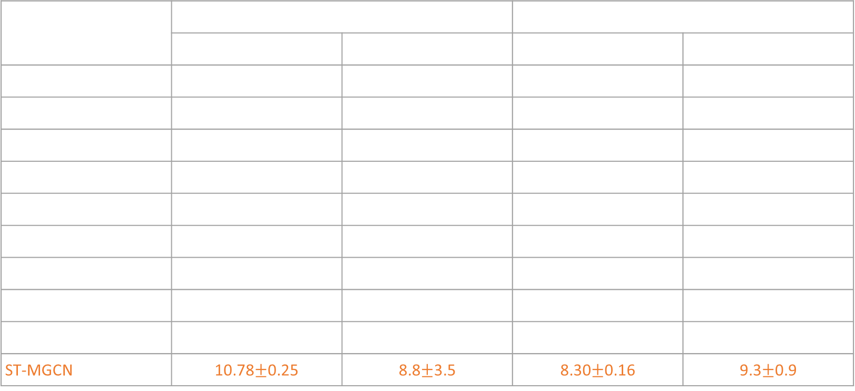
Experiment
Methodology | City 1 |  | City 2
 | RMSE | MAPE(%) | RMSE | MAPE
HA | 16.14 | 23.9 | 17.15 | 34.8
LASSO | 14.24$±$0.14 | 23.8$±$0.8 | 10.62$±$0.06 | 22.9$±$0.8
Ridge | 14.24$±$0.11 | 23.8$±$0.9 | 10.61$±$0.04 | 23.1$±$0.8
VAR | 13.32$±$0.17 | 22.4$±$1.6 | 10.54$±$0.18 | 23.7$±$1.4
STAR | 13.16$±$0.22 | 22.2$±$1.9 | 10.52$±$0.21 | 23.2$±$1.4
GBM | 13.66$±$0.16 | 23.1$±$1.5 | 10.25$±$0.11 | 23.4$±$1.2
STResNet | 11.77$±$0.95 | 14.8$±$6.0 | 9.87$±$0.94 | 14.9$±$6.0
DMVST-Net | 11.62$±$0.48 | 12.3$±$5.5 | 9.61$±$0.44 | 13.8$±$1.2
ST-GCN | 11.62$±$0.36 | 10.1$±$5.1 | 9.29$±$9.31 | 11.2$±$1.3
ST-MGCN | 10.78$±$0.25 | 8.8$±$3.5 | 8.30$±$0.16 | 9.3$±$0.9
1km*1km rectangle grid, 30min time interval
MORE THAN JOURNEY didiglobal.com

Slide 7






Collaborative Supply and Demand Forecasting
Collaborative Problem
Probabilistic Forecasting
Given $q∈Q=\left\{10\%,50\%,90\%\right\},$then quantile loss ${QL}_{q}$ at each point $q$ is denoted as:
$$P\left(x_{v}\left(t+1:t+τ_{max}\right) | x_{v}\left(:t\right),z_{v}\left(:t+τ_{max}\right)\right), \left(1\right)$$
$P\left(y_{v}\left(t+1:t+τ_{max}\right) | y_{v}\left(:t\right),x_{v}\left(:t+τ_{max}\right),z_{v}\left(:t+τ_{max}\right)\right), (2)$
$${QL}_{q}\left(x_{t},{\hat{x}}_{t−τ}^{q}\right)=\left\{q−I\left(x_{t}≤{\hat{x}}_{t}^{q}\right)\right\}\left(x_{t}−{\hat{x}}_{t}^{q}\right).$$
where,
$x_{v}(t)$is demand at time $t$ in grid $v$;
$y_{v}(t)$ is supply at time $t$ in grid $v$;
$z_{v}(t)$ is external covariates (e.g. weather and holiday) at time $t$ in grid $v$;
$τ_{max}$ is a pre-specified time length, and grid $v∈𝕍$.
Then final quantile loss is:
${Loss}_{Q}=$ $\sum_{x_{t}∈Ω}{\sum_{q∈Q}{\sum_{τ=1}^{τ_{max}}{\frac{{QL}_{q}(x_{t},{\hat{x}}_{t−τ}^{q})}{M∙τ_{max}}}}}.$
We introduce quantile risk as a key metric:
$${Risk}_{q}=\frac{2\sum_{x_{t}∈\tilde{Ω}}{\sum_{τ=1}^{τ_{max}}{{QL}_{q}(x_{t},{\hat{x}}_{t−τ}^{q})}}}{\sum_{x_{t}∈\tilde{Ω}}{\sum_{τ=1}^{τ_{max}}{\left|x_{t}\right|}}},$$
where $\tilde{Ω}$ is the test dataset.

Slide 8
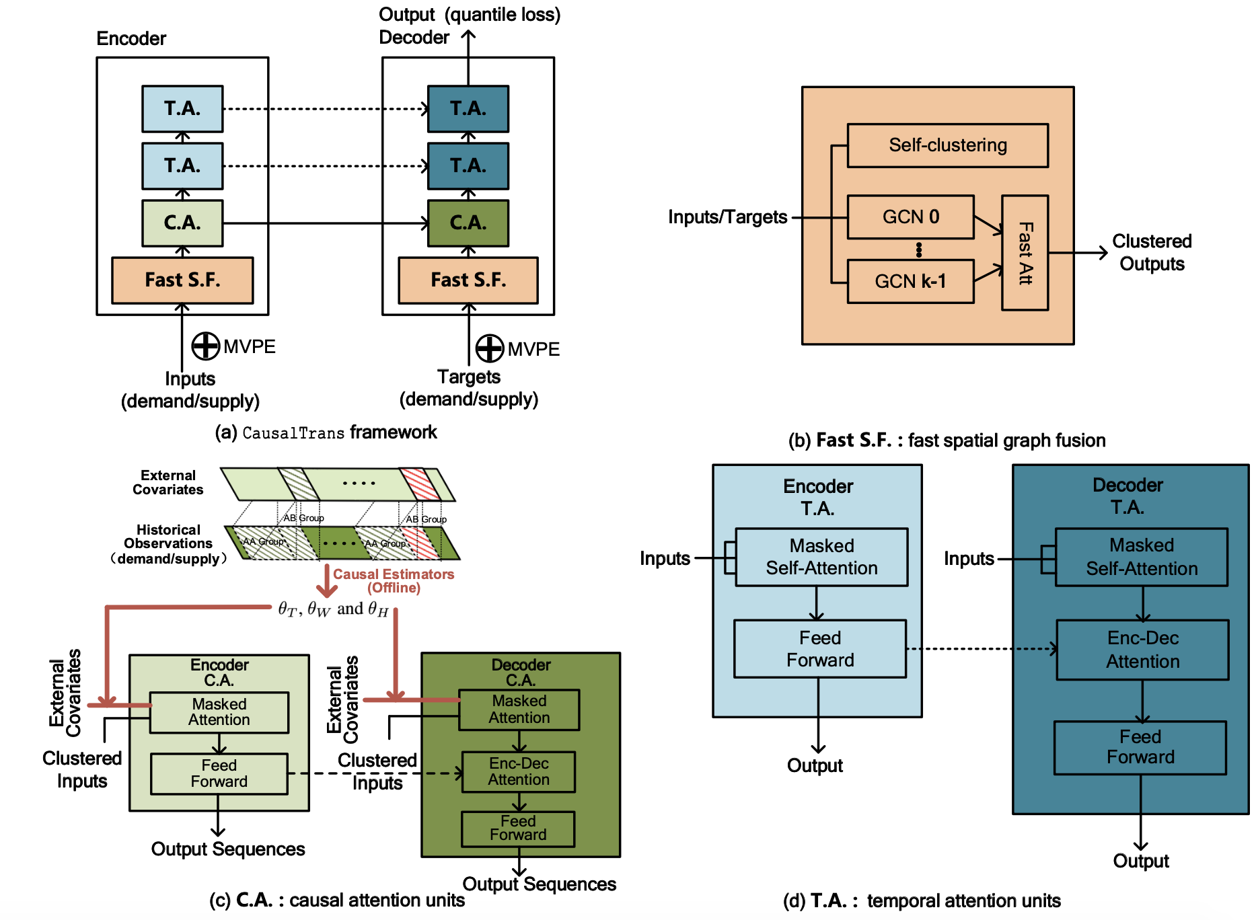
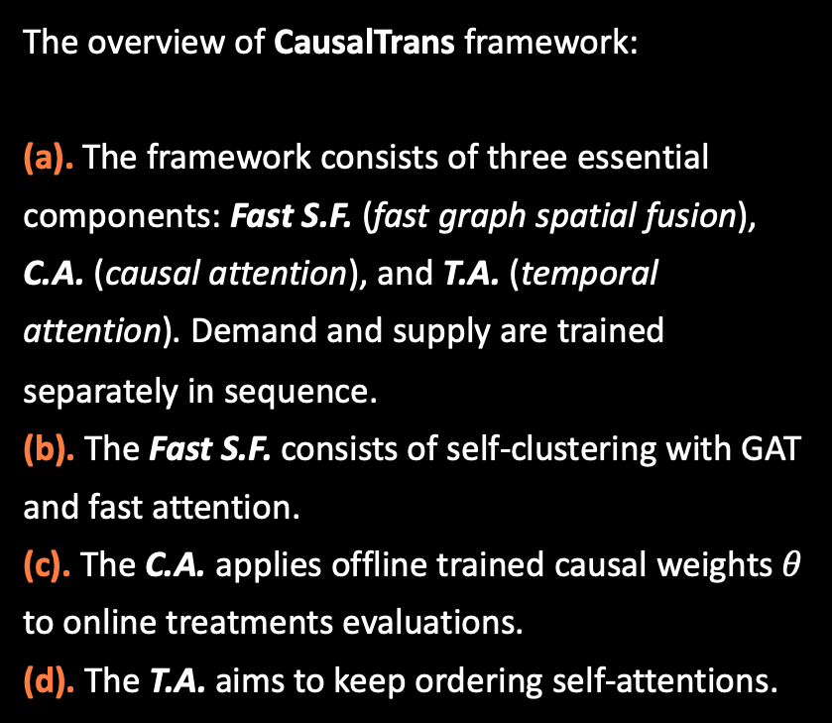
Causal Transformer Framework
The overview of CausalTrans framework:
(a). The framework consists of three essential components: Fast S.F. (fast graph spatial fusion), C.A. (causal attention), and T.A. (temporal attention). Demand and supply are trained separately in sequence.
(b). The Fast S.F. consists of self-clustering with GAT and fast attention.
(c). The C.A. applies offline trained causal weights $θ$ to online treatments evaluations.
(d). The T.A. aims to keep ordering self-attentions.

Slide 9
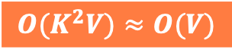
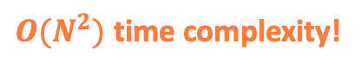
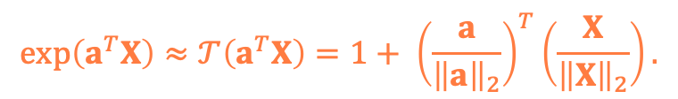
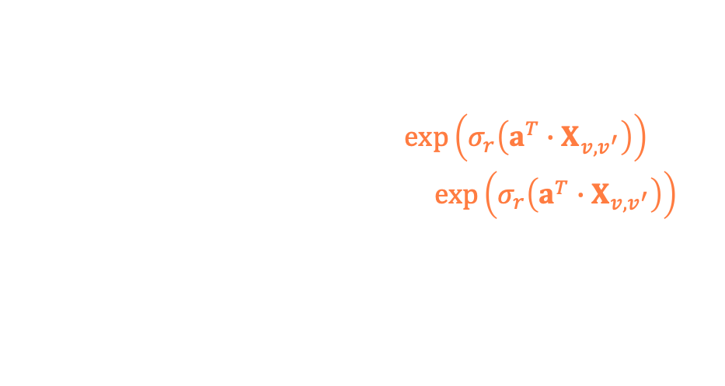

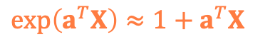
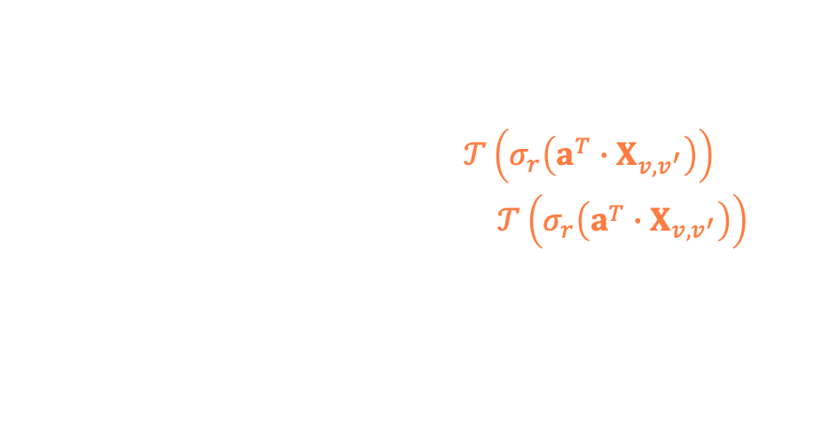
Fast Spatial Graph Fusion Attention
Based on Clustered attention for unsmoothness above, spatial graph attention is as follows:
$${\hat{α}}_{v}=\sum_{v^{′}∈N_{v}}{α_{v,v^{′}}∙x_{v^{′}}=\frac{\sum_{v^{′}∈N_{v}}{\exp\left(σ_{r}\left(a^{T}∙X_{v,v^{′}}\right)\right)∙x_{v^{′}}}}{\sum_{v^{′}∈N_{v}}{\exp\left(σ_{r}\left(a^{T}∙X_{v,v^{′}}\right)\right)}}.}$$
$O(N^{2})$ time complexity!
Theoretically, we have Taylor expansion:
$$\exp\left(a^{T}X\right)≈1+a^{T}X,$$
when $𝔼(a^{T}X)≈0$and $Var(a^{T}X)≈1.$
We introduce $L_{2}$ normalization to ensure small $a^{T}X$ and positive $1+a^{T}X$, then we have:
$$\exp\left(a^{T}X\right)≈𝒯\left(a^{T}X\right)=1+ {\left(\frac{a}{{\left\|a\right\|}_{2}}\right)}^{T}\left(\frac{X}{{\left\|X\right\|}_{2}}\right).$$
Finally, we have approximate linear attention:
$${\hat{α}}_{v}=\sum_{v^{′}∈N_{v}}{α_{v,v^{′}}∙x_{v^{′}}=\frac{\sum_{v^{′}∈N_{v}}{𝒯\left(σ_{r}\left(a^{T}∙X_{v,v^{′}}\right)\right)∙x_{v^{′}}}}{\sum_{v^{′}∈N_{v}}{𝒯\left(σ_{r}\left(a^{T}∙X_{v,v^{′}}\right)\right)}}.}$$
$$O(K^{2}V)≈O(V)$$
Cluster number
Grid number

Slide 10
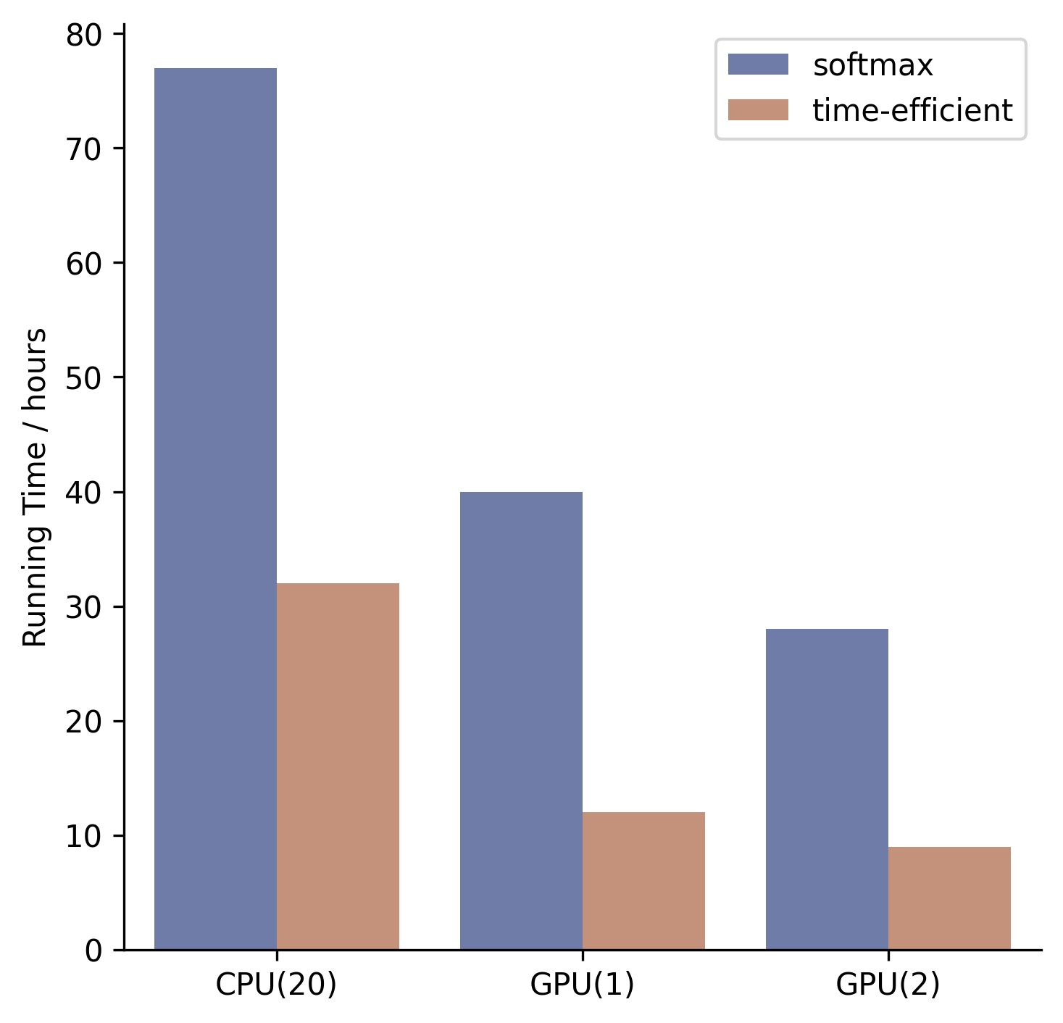
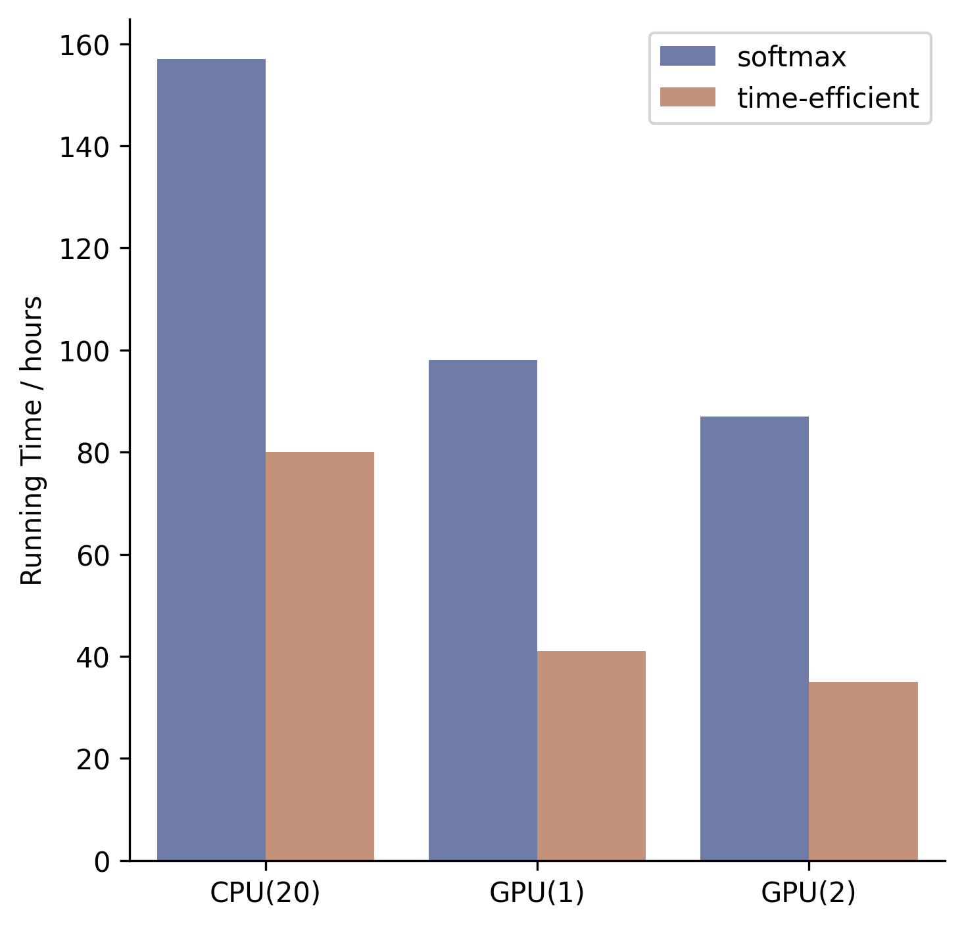
Fast Spatial Graph Fusion Attention
Time Efficiency Improvement
The numbers in brackets mean logic cores in a chip. CPU(20) utilizes multiple processing to accelerate matrix multiplication.
The comparison of GPU(1) and GPU(2) aims to demonstrate a possibility of applying powerful GPUs in real world.
Setting up (a) 3 heads and (b) 5 heads in multi-head attention is quite different. The less number of heads, the shorter running hours.
Each running hour result is averaged by using three independent experiments.
(a) Multi-head = 3.
(b) Multi-head = 5.
Time efficiency improvements on one-day demand prediction in city A

Slide 11


Fast Spatial Graph Fusion Attention
More discussion
1. Kernel Function:
$$Attention\left(Q,K,V\right)=softmax\left(Q^{T}K\right)V={φ(Q)}^{T}∙φ\left(K\right)∙V$$
 | Kernel function | Complexity
Katharopoulos et al. (2020) | $$φ\left(x\right)=φ\left(x\right)=elu\left(x\right)+1$$ | $$O(N)$$
Shen et al. (2018) | $$φ\left(x\right)=softmax\left(x\right),φ\left(x\right)=e^{x}$$ | $$O(N)$$
2. Matrix Projection:
$$Attention\left(Q,K,V\right)=softmax\left(Q^{T}(EK)\right)FV$$
 | Key idea | Complexity
Child et al. (2019) | $$\text{matrix} \text{factorizations}$$ | $$O(N\sqrt{N})$$
Kitaev et al. (2020) | locality-sensitive hashing | $$O(Nlog(N))$$
Wang et al. (2020) | low-rank matrix | $$O(N)$$

Slide 12
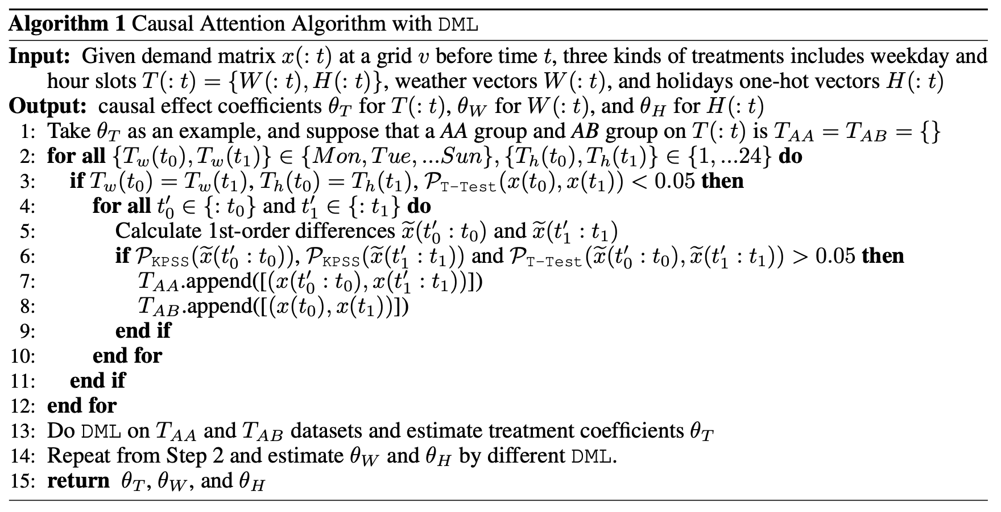
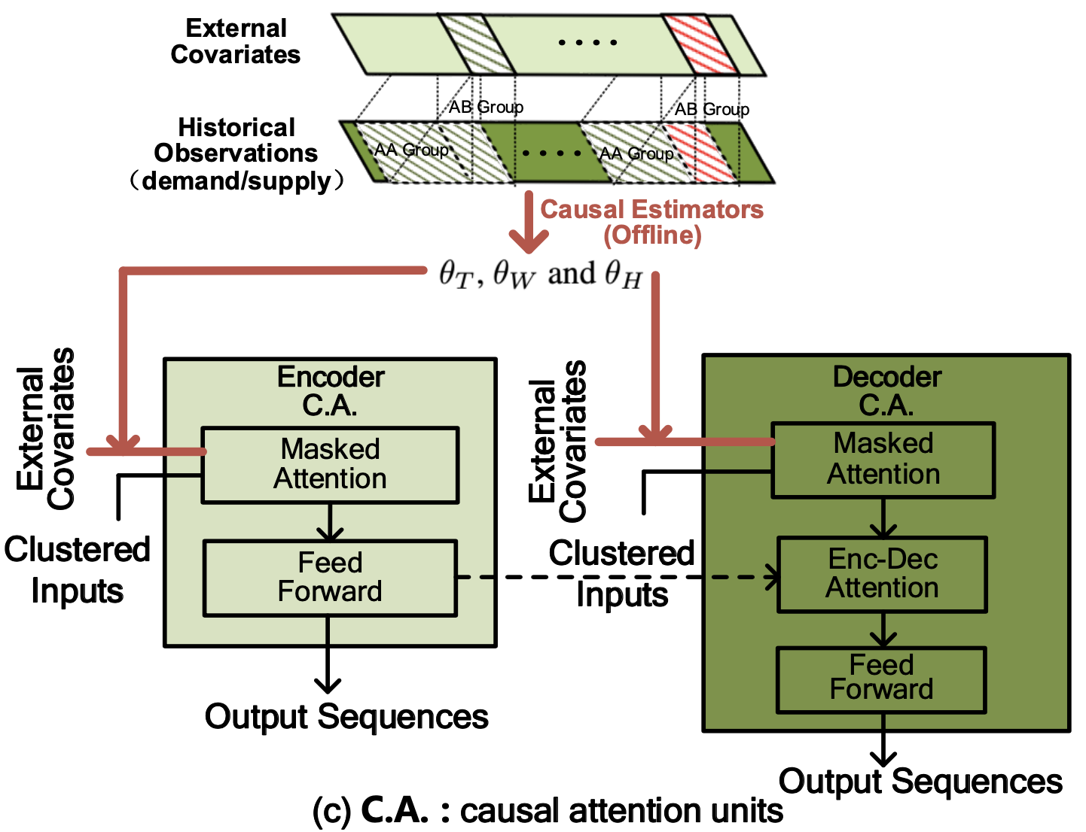
Causal Attention Mechanism
We transfer the weights of external covariates to causal weights by HTE methods (e.g. double machine learning).
(a) causal attention algorithm
(b) how to work in ConvTrans
step 1: external covariates: weather, holidays and subsidy;
step 2: build various of control groups and treat groups;
step 3: do DML and get causal attention or weights.
step 1: offline training causal attention;
step 2: add above weights in multi-head attention.

Slide 13
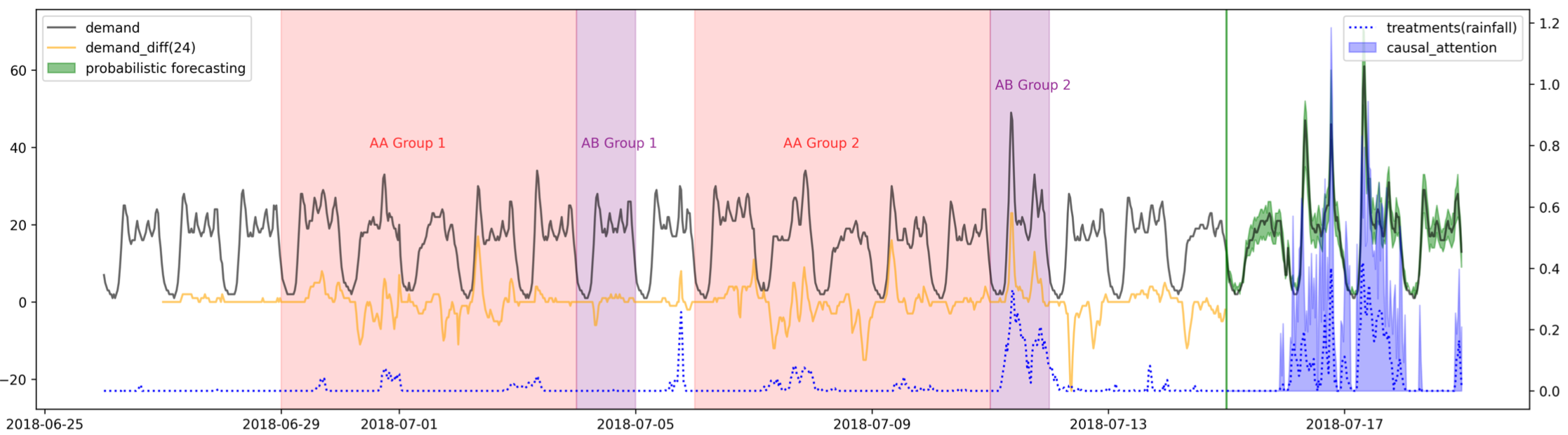
Causal Attention Mechanism
Causal Attention Visualization
Rainfall
Predicted Demand
Real Demand
Rainfall
Attention
“AA group 1” and “AA group 2” are regarded as comparable contexts;
“AB group 1” and “AB group 2” is control group and treatment group;
Do DML and get causal attention weights.

Slide 14
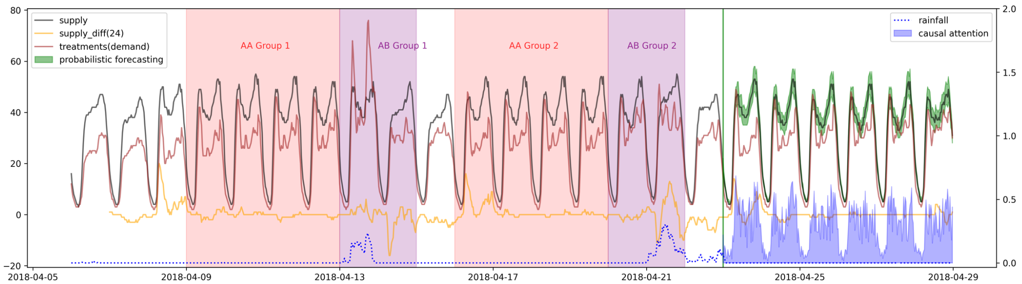
Causal Attention Mechanism
Causal Attention Visualization
Demand
Predicted Supply
Attention
Real Supply
Demand
estimate collaborative demand causal effects by adding rainfall causal effects;
mean difference of both AA groups in t-test is not significant;
causal attention distributed in (0, 1).

Slide 15
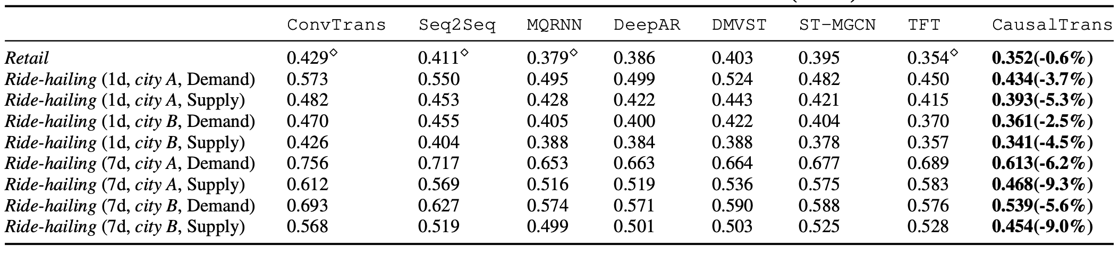
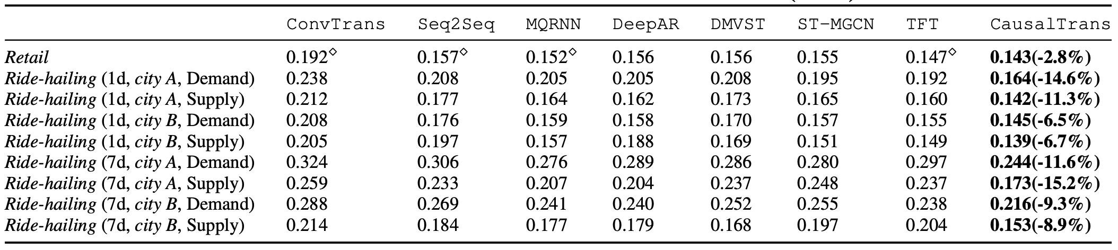
Experiments
(a) ${Risk}_{50\%}$ losses on the retail and ride-hailing datasets.
Use grid search to optimize hyperparameters;
DeepAR outperforms Seq2Seq and MQRNN because of Poisson and weather covariates;
CausalTrans outperforms other methods primarily due to causal estimator DML;
CausalTrans achieves lower losses on supply than demand based on both causal relationship;
Long-term prediction focuses on unbiased distribution estimation.
(b) ${Risk}_{90\%}$ losses on the retail and ride-hailing datasets.

Slide 16
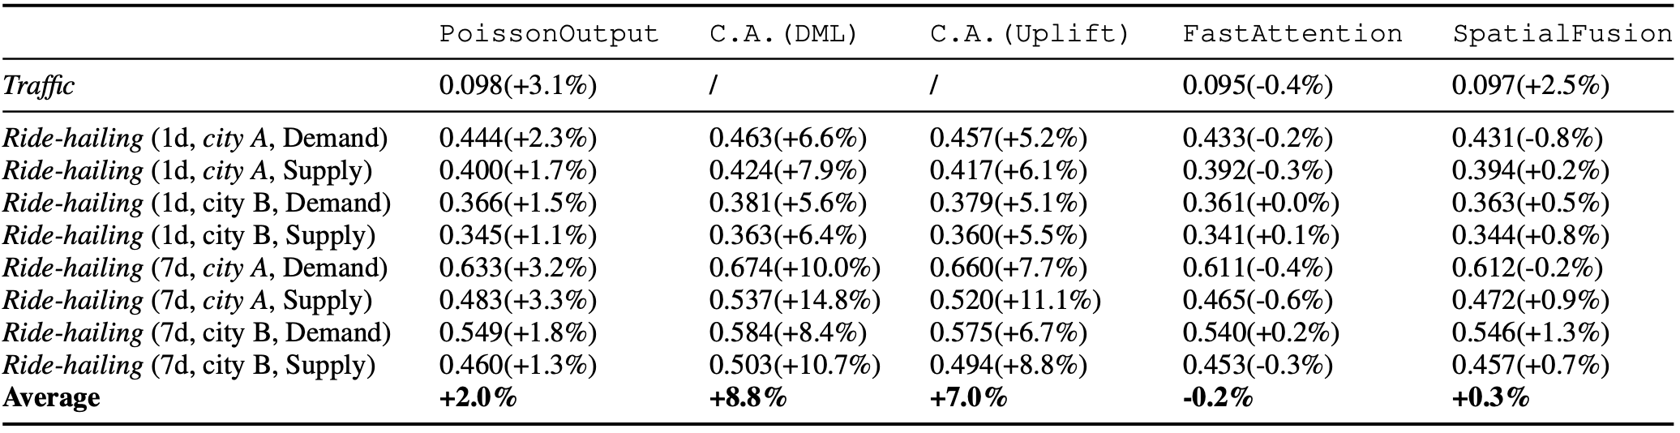
Causal Attention Mechanism
Ablation Analysis
Lack of PoissonOutput increases 2% loss on average;
C.A.(DML) improves collaborative supply forecasting more than demand;
Long-term prediction depends on C.A.(DML) as well as the causal covariates;
C.A.(Uplift) is similar to C.A.(DML), but the simpler C.A.(Uplift) means less importance.

